Slide 1
Tripster
Your trip collaborator

Slide 2

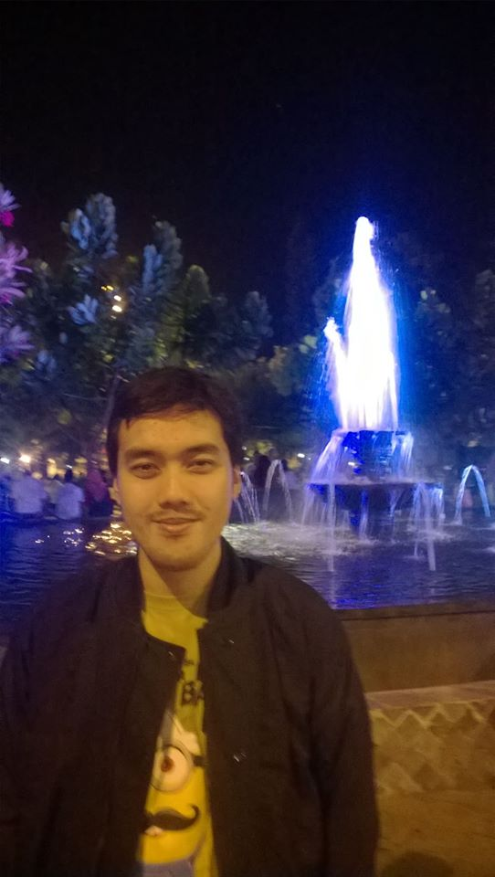

Teams
Iffah
Wildan
Indra

Slide 3
Contents
Executive Summary
Background
Objective
Architecture
Core Code & Demo
Executive Summary | Background | Objective | Architecture | Core Code & Demo

Slide 4







Trip announcement among close friend based on web service
Many people in a circle has their own plan for trip, some of the plan will be better to do together.
2
3
1
Roles In the TRIP
Basic Requirement
Planning Interface
Tripster
Our trip announcer
Using MySQL
Using NodeJS ejs style
Using HTML, AgnularJS, CSS and bootstrap
Executive Summary | Background | Objective | Architecture | Core Code & Demo

Slide 5

Background
With 20 people, the possibility of trips enormous.
Executive Summary | Background | Objective | Architecture | Core Code & Demo

Slide 6

Background
However, some prefer to join a planned trip
Executive Summary | Background | Objective | Architecture | Core Code & Demo

Slide 7

Background
while some other prefer to make the plan and offer anyone to join
Executive Summary | Background | Objective | Architecture | Core Code & Demo

Slide 8
Executive Summary | Background | Objective | Architecture | Core Code & Demo

